Slide 1
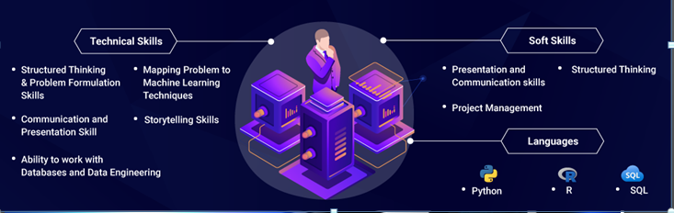
Data Engineering & Management

Slide 2
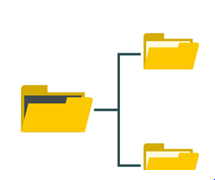
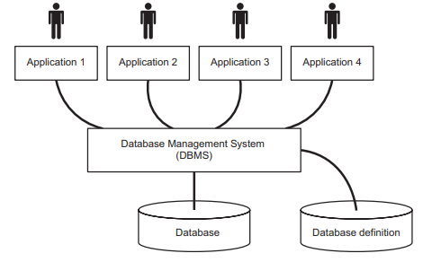
DB Architecture for an IS
File System - Designed for and associated with app. Pgms.
- Issues
- Sequential & Direct access
- Location depends on Data structure
DB Approach - Two data store
DB and DB defn. - Schema – Set of Data defn.
Data Independence Integration & sharing of data
Consistency of data Data redundancy
Integrity controls Acess and responsibility
Ease development & maintenance

Slide 3
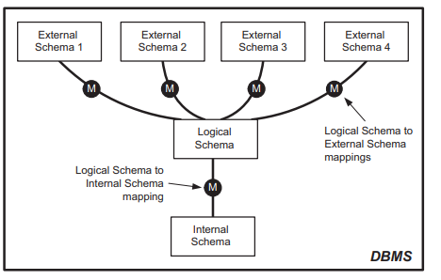
The three-level schema architecture
Proposed by the ANSI Standards Planning and Requirements Committee (SPARC) in 1975
The schema at the logical level is the central, and main, component of the architecture. It defines the properties of all the data.
The schema at the internal level defines how the database is physically stored in files and how these files are accessed.
Each schema at the external level defines the data required to support one or more user processes

Slide 4
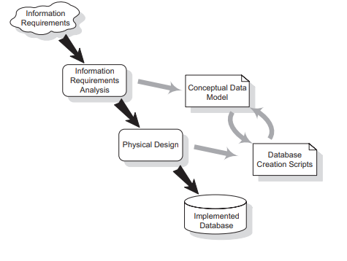
DATABASE DEVELOPMENT PROCESS
IS meets requirements – help business process

Slide 5
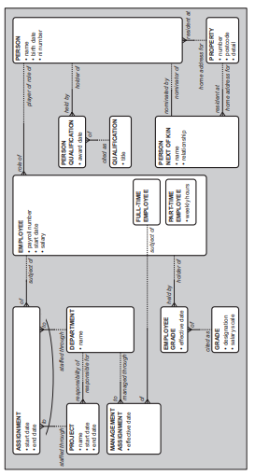
Conceptual Model
UML notation – Ellis Barker
ER Modeling – Richard Barker 1990
Cons – Covers data requirement our business area & perspective single project – No formal documentation

Slide 6
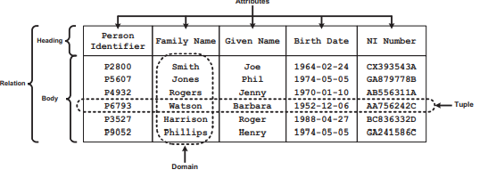
Relational Model
Relational data analysis is based upon the relational model of data proposed by Edgar F. Codd (1970)
A relation has two parts – a heading and a body.
The heading consists of a set of attributes
body is a set of elements that are called tuples. Tuple is a set of attribute-name:attribute-value pairs.

Slide 7
Normalization
A large database defined as a single relation may result in data duplication. This repetition of data may result various issues:
What is Normalization?
Normalization is the process of organizing the data in the database.
Normalization is used to minimize the redundancy from a relation or set of relations. It is also used to eliminate undesirable characteristics like Insertion, Update, and Deletion Anomalies.
Normalization divides the larger table into smaller and links them using relationships.
The normal form is used to reduce redundancy from the database table.

Slide 8
Why do we need Normalization?
The main reason for normalizing the relations is removing these anomalies.
Insertion Anomaly: Insertion Anomaly refers to when one cannot insert a new tuple into a relationship due to lack of data.
Deletion Anomaly: The delete anomaly refers to the situation where the deletion of data results in the unintended loss of some other important data.
Updatation Anomaly: The update anomaly is when an update of a single data value requires multiple rows of data to be updated.

Slide 9
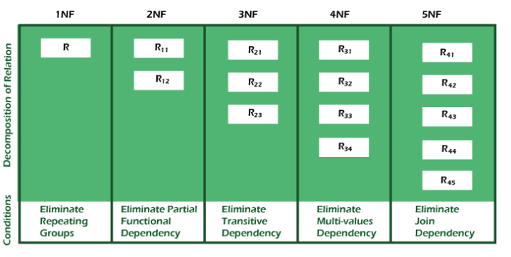

Slide 10
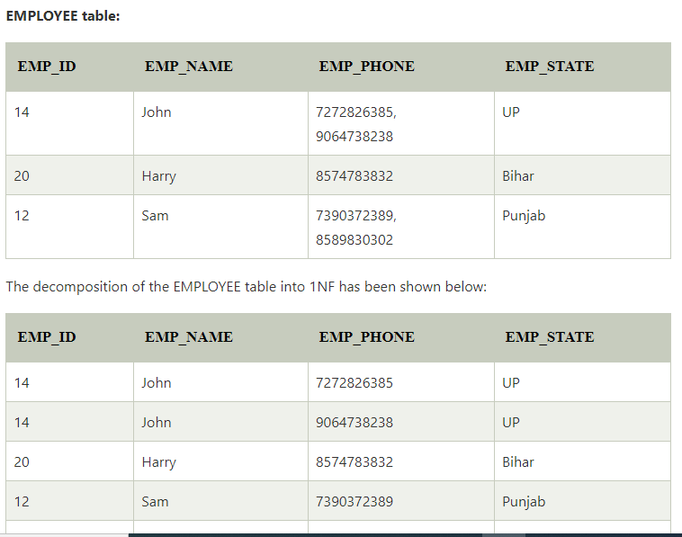
1NF

Slide 11
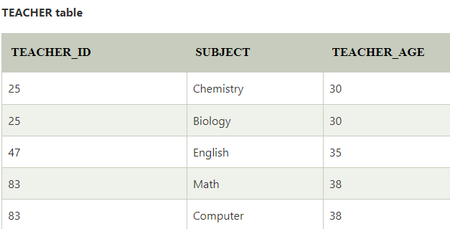
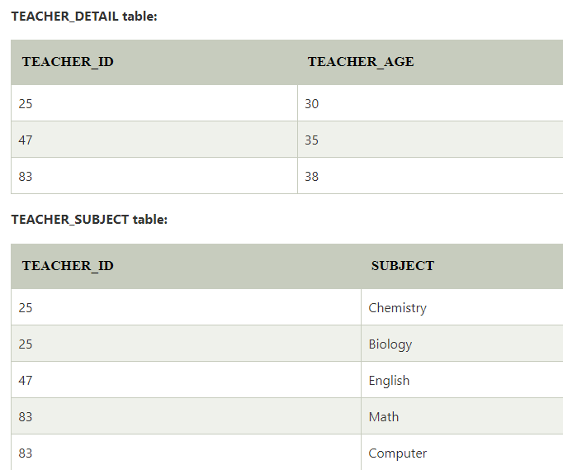
In the 2NF, relational must be in 1NF. In the second normal form, all non-key attributes are fully functional dependent on the primary key

Slide 12
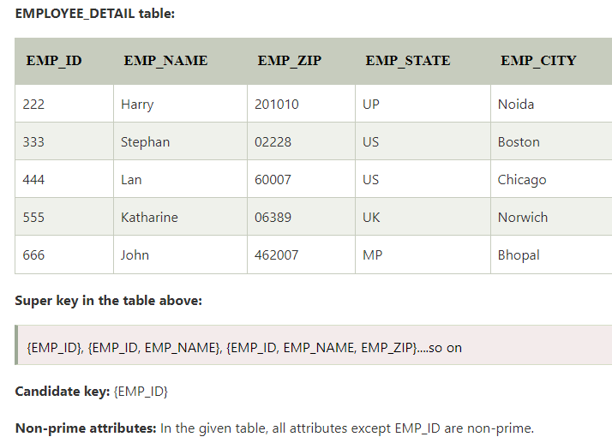
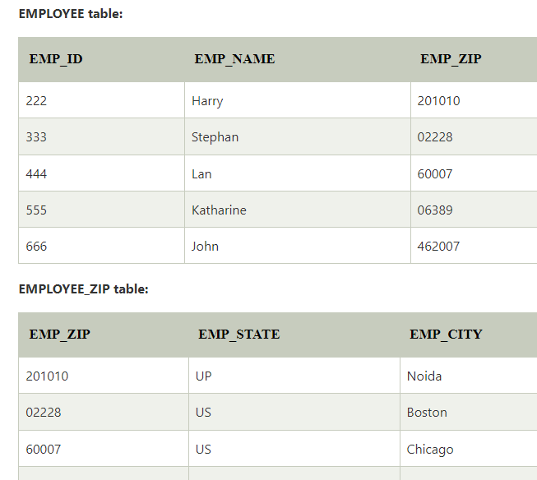

Slide 13
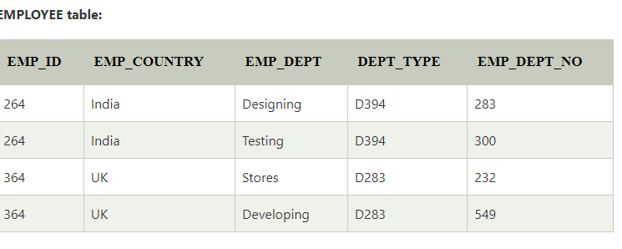
BCNF
A table is in BCNF if every functional dependency X → Y, X is the super key of the table. For BCNF, the table should be in 3NF, and for every FD, LHS is super key.
Example: Let's assume there is a company where employees work in more than one department.

Slide 14
BCNF
Example: Let's assume there is a company where employees work in more than one department.
In the above table Functional dependencies are as follows:
EMP_ID → EMP_COUNTRY
EMP_DEPT → {DEPT_TYPE, EMP_DEPT_NO}
Candidate key: {EMP-ID, EMP-DEPT}

Slide 15
BCNF
The table is not in BCNF because neither EMP_DEPT nor EMP_ID alone are keys.
To convert the given table into BCNF, we decompose it into three tables:
EMP_COUNTRY table:
EMP_DEPT table:
EMP_DEPT_MAPPING table:

Slide 16
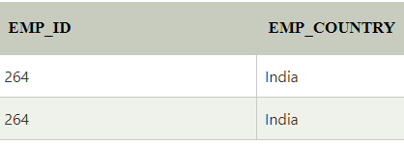
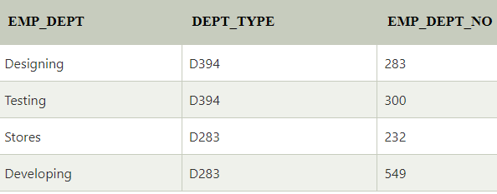
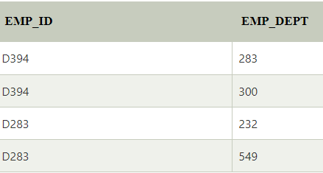
BCNF
EMP_COUNTRY table: EMP_DEPT table:
EMP_DEPT_MAPPING table:
Functional dependencies:
EMP_ID → EMP_COUNTRY
EMP_DEPT → {DEPT_TYPE, EMP_DEPT_NO}
Candidate keys:
For the first table: EMP_ID For the second table: EMP_DEPT For the third table: {EMP_ID, EMP_DEPT}

Slide 17
THE ROLES OF A DATA MODEL
Conceptual data models can be developed to understand the information requirements of a business and to form the basis for a physical database design to support the business.
Understanding information requirements
Aim is highlight the inconsistencies
The basis for physical database design
A conceptual data model, that is a data model that has been developed to understand information requirements
Physical database design
Once the conceptual data model is complete it provides the start point for the design of the physical database

Slide 18
THE ROLES OF A DATA MODEL
‘Physical database design’ process has two stages:
First-cut database design
Optimised database design.
Understanding information requirements
Aim is highlight the inconsistencies
The basis for physical database design
A conceptual data model, that is a data model that has been developed to understand information requirements
Physical database design
Once the conceptual data model is complete it provides the start point for the design of the physical database

Slide 19
THE ROLES OF A DATA MODEL
First-cut database design
The aim is to use the conceptual constructs of the logical-level schema of the target database management system to develop a design that matches the conceptual data model as closely as possible.
Each entity type conceptual data model becomes a table, with each of the attributes of the entity type becoming a column of that table. If the foreign keys needed add the column if not exists
Naming of tables and column relates to schema
There has to be an explicit primary key declaration for each table
Another important element of the first-cut database design is the specification of the file storage

Slide 20
THE ROLES OF A DATA MODEL
Optimised database design stage
The first-cut design gives a database design that closely resembles the conceptual model
Such a design should be robust, easy to understand and meet all the requirements
Enhance or move away from the first-cut design to improve the performance of the DB, there are two stages
Make use of the built-in facilities of the database management system;
Compromise on the design of the logical schema.
Two facilities provided by most database management systems are
The ability to cluster data and the ability to create indexes.
Data clustering means arranging data
Indexing provide another way to access

Slide 21
Data Management
Data management is a corporate service which helps with the provision of information services by controlling or co-ordinating the definitions and usage of reliable and relevant data.
The Problems Encountered Without Data Management
The information systems within the enterprise cannot be interfaced.
Data is not shared between the information systems. Even if it is possible
Communication breaks down and information gets lost.
Data is unnecessarily transcribed and rekeyed.
The wheel keeps being reinvented.
The competitive edge of the organization is reduced.
Frustration sets in

Slide 22
Data management responsibilities
Strategically supports the corporate definition, management and use of business data
Operationally supports the development and maintenance of computerised information systems
Key areas of responsibilities
Achieving recognition of data
Improving the quality of data
Facilitating information share
Making various level of management
Achieving single source of reference data to support
To fulfil the above responsibilities, the data management function needs to identify the specific activities that it needs to carry out and then obtain sufficient resources to perform the activities.

Slide 23
Data management activities
Educate the importance of data mgmt
Develop the corporate data definitions
The functional mgmt ensure all activities are coordinated & facilitated
The IT or IS department is often cast in the role of ‘advocate’ for the creation and implementation of a data management function.

Slide 24
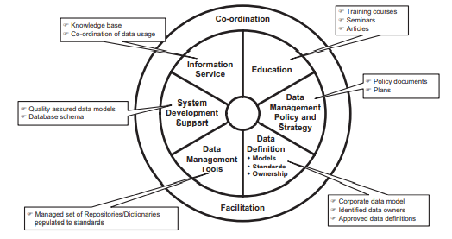
Data management deliverables

Slide 25
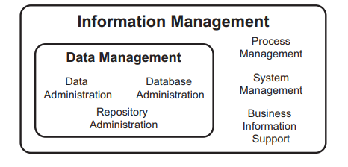
Roles within data management

Slide 26
Roles within data management
Information Management
Process Mgmt – Looks at the processes that use data;
System management -which is the management of the computer systems that support the business processes;
Business information support, which provides a service to the business users to enable them to exploit the information available.
Data Management
Data administration – Mechanism of definitions, QC & accessibility
Database administration - is concerned with the management and control of the software used to access physical data.
Repository administration - is concerned with the management and control of the software in which ‘information about information’ is stored, manipulated and defined.

Slide 27
Benefits of data management
Benefits related to cost savings
Business related benefits
Increased availability of information
Improvement in data quality
Improvement in overall efficiency & effectiveness
Helps to improve the customer service & competition edge
Information related benefits
Reuse of Information and data analysis products
Increase productivity in Sys. Development & leading to cost saving

Slide 28
The relationship between data management and enterprise architecture
US Department of Defense Architecture Framework (DoDAF)
UK Ministry of Defence Architecture Framework (MODAF)
DoDAF (dodcio.defense.gov/dodaf20.aspx) and MODAF (www.modaf.com) are specifically targeted at the defence communities of the respective nations.
Open Group Architecture Framework (TOGAF)
TOGAF (www.opengroup.org/togaf) is an enterprise architecture framework, developed by members of The Open Group Architecture Forum (www.opengroup.org/architecture), that uses models at four levels: Business, Application, Data and Technology.
Framework for Enterprise Architecture developed by John Zachman
Consists of six column & Six rows

Slide 29
The relationship between data management and enterprise architecture
Framework for Enterprise Architecture developed by John Zachman
Consists of six column –
What – Inventory sets
How – Process flow
Where – Distribution network
Who – Responsibility assignments
When – Timing cycle
Why – Motivation intensions
Six rows
The ‘executive perspective’ – the view of the business context planners
The ‘business management perspective’ – the view of the business concept owners
The ‘architect perspective’ – the view of the business logic designers
The ‘engineer perspective’ – the view of the business physics builders
The ‘technician perspective’ – the view of the business component implementers
The sixth row represents the functioning enterprise

Slide 30
Corporate Data Model
Why? - Relates similar to Conceptual data model
It comprises
Business interest – Entity
Info about the things- Attributes
Is the corporate model used as
Business model
DB design model
Interface design model
Nature of Corporate data model
Scope – Beyond the single Information System
Support all future systems

Slide 31
DEVELOP A CORPORATE DATA MODEL
Three approach
Attribute-trawling approach (Bottom approach)
Joining multiple project model or Area model
Top down approach
Attribute trawling approach
Studying all existing information
Collecting data definitions
Sorting and Reuse the definitions
Problems
Some Business processes not supported by IS
IS will not meet the requirements
It is unclear the data definitions are analyzed and compared

Slide 32
DEVELOP A CORPORATE DATA MODEL
Joining multiple project model or Area model
It involves the independent modeling of information or data requirements of the separate business areas within the enterprise.
These models are o form an enterprise-wide corporate data model.
However, this approach often fails, even when a common set of modelling standards is used.
The reason for these failures is exactly because the models are developed independently of each other.
Top down approach
Building top-down implies the development of a single conceptual data model that, from its inception, is intended to cover the complete information and data requirements of enterprise
The best approach is to build the corporate data model ‘topdown’, starting from a core or framework model that represents the major objects and Concepts of business

Slide 33
CORPORATE DATA MODEL PRINCIPLES
Develop the model ‘top-down’
Give primacy to the core business
Cover the whole enterprise
Future-proof the model
Develop co-operatively
Gain consensus, not perfection

Slide 34
DATA NAMING CONVENTIONS
The purpose of a data naming convention
To provide consistent, unique and meaningful names for all existing and new items within the enterprise’s common data resource.
A consistent approach to data naming should be applied across the enterprise to help achieve unambiguous understanding of data.
A typical data naming convention
Either single words or a number of words, in a precise and predefined manner.
Mandatory prime term that provides the context of the data, which normally means the entity type or table holding the ‘data item’;
One or more optional modifier terms that are used to make the meaning of the data explicit;
A mandatory class term that indicates the ‘class’ of the data.
Two problems : Over prescriptive & May not deliver what expected

Slide 35
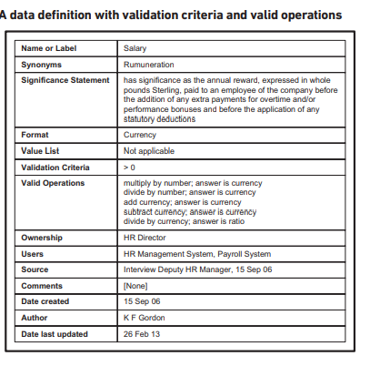
DATA DEFINTIONS & NAMING

Slide 36
Data Quality
Quality – Fitness of use
Data quality – Satisfy the requirements of intended use
Poor data quality – Issues leads to
Rework
Implement new systems
Delay in delivery
Lost of customers
Supply chain problem

Slide 37
Data Quality
Causes of Poor data quality
Inappropriate schemas in DB
Data entry errors
Data decay (destroyed over time)
Data corruption
Lack of understanding

Slide 38
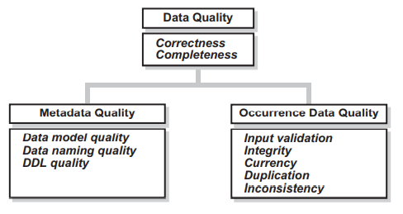
Dimension of Data Quality
Completeness – Assesses - data reflect to real world
Correctness –Assesses – Data has constraints & validation

Slide 39
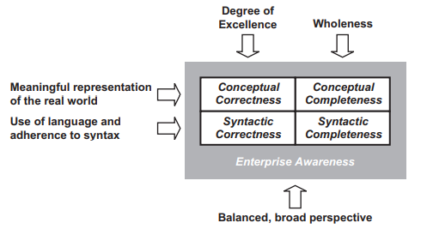
Data model Quality
Assesses – Quality of conceptual data model
Approaches – Qualitative & Quantitative

Slide 40
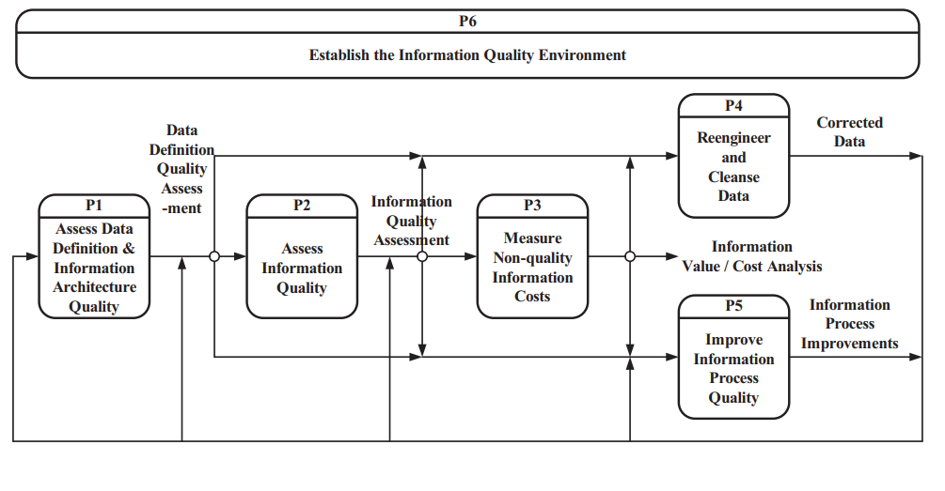
Improving Data Quality
To achieve enduring quality – Enterprise implement
Set of Procedures & Culture
Larry English – TQdM

Slide 41
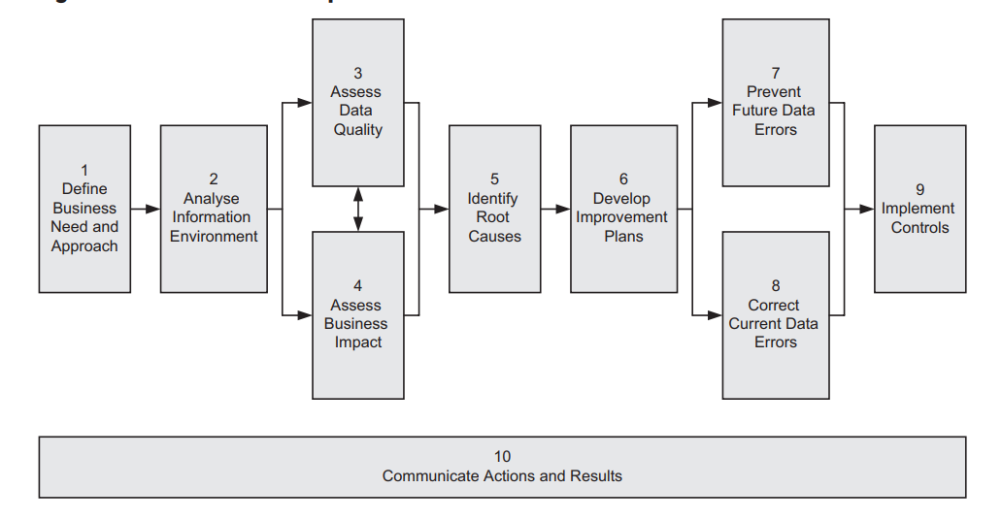
Ten step processes

Slide 42
Data Accessibility
Data Security - Protecting DB
Create – Data security policy – Enforce security mechanism
Access control – Rely on authentication process
Ensure the user processes
Granting & Revoking privileges
Table privileges
Function & procedure privileges
Database object privileges
Discretionary & mandatory access controls
Granted access rights to others
Access rights cannot be changed by the users
Multilevel Security – two user get two results in same data

Slide 43
Data Accessibility
Encryption
Audit trails
DATA INTEGRITY – Protecting the DB against authorized users
Constraints – That ensure the data consistency & complies with business rules
Rules
All candidate key are unique
Entity integrity – Primary key Component – Not null
Referential Integrity – Foreign key values must be matched

Slide 44
Data Accessibility
Data Recovery – Restoring the DB after failure
Causes of failure
Transaction failure – ACID properties
Atomicity
Consistency
Isolation
Durability
System crashes
Media failures
Recovery Mechanism
Physical redundancy of data
Back up / Disk mirroring
Data is held in more than one operational DB

Slide 45
Data Management Environment
Use of Packaged Application Software
Ready to use – Specific, but It support related operations
Financial Packages – Support sales, purchase, & stock
Human resource package – Recruitment, Training & payroll
It appropriate for broad range of business
It is relatively cheap & deliver speedy business
Issues – It does not support sharing
Need “bespoke” interface

Slide 46
Data Management Environment
Impact on Data Management
To be addressed - Data mgmt perspective – Packages has issues
Not reliable conceptual model for data sharing
Doesn’t meet the functional & local requirements
How to adopt & handle new versions of packages?
When the true costs of developing, maintaining and managing interfaces as well as the tailoring required by the business area are included in the cost–benefit analysis.
Off-the shelf application packages often turn out to be a more expensive option than bespoke development

Slide 47
Distributed Data and Databases
Rationale for Distributed Data
Large enterprise – Geographically dispersed – Still use single centralized database
Principle reasons for choose Distributed DB
Work is not disturbed by communication failures
Existing system dispersed through the enterprise with own DB – So Data managed as cohesive whole
Distributed data provide greater
Reliability & availability with reduced response time
Decide – What data to be store – Where & How managed
Top down data distribution & Bottom up integration

Slide 48
Distributed Data and Databases
Perfect Distributed Database System
Chris Dates – States that
Fundamental Principles - To the user, a distributed system should look exactly like a non-distributed system.
12 Objectives
Local autonomy | Distributed query processing
No reliance on central site | Distributed transaction mgmt
Continuous operations | H/W independence
Location independence | OS Independence
Replication transparency | N/W independence
Fragmentation transparency | DB independence

Slide 49
Distributed Data and Databases
Top down fragmentation & Partioning
The development of a set of local logical schemas from a global logical schema involves using the techniques of fragmentation and partitioning.
Fragmentation is the splitting of a table (or relation) into fragments, each of which represents a distinct subset of the data required at one or more specific sites.
Partitioning then involves combining fragments
So that all the fragments required at a particular site are grouped into a partition.
Fragmentation – Vertical, Horizontal & Hybrid

Slide 50
Distributed Data and Databases
Top down fragmentation & Partioning
The development of a set of local logical schemas from a global logical schema involves using the techniques of fragmentation and partitioning.
Fragmentation is the splitting of a table (or relation) into fragments, each of which represents a distinct subset of the data required at one or more specific sites.
Partitioning then involves combining fragments
So that all the fragments required at a particular site are grouped into a partition.
Fragmentation – Vertical, Horizontal & Hybrid

Slide 51
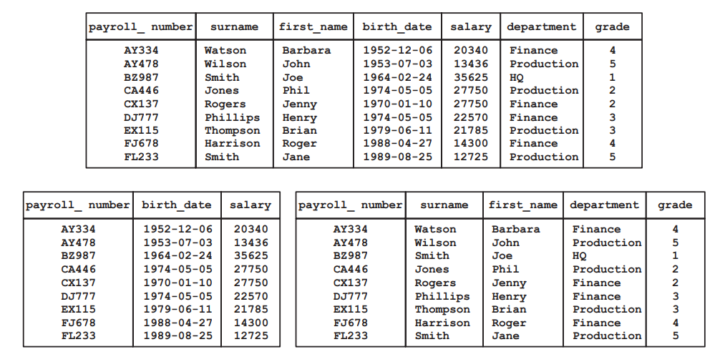
Vertical Fragmentation – Primary key in all fragments

Slide 52
Distributed Data and Databases
Horizontal fragmentation involves the assignment of the rows of the table to one (and only one) fragment.
Hybrid fragmentation is a combination of the vertical and horizontal fragmentation where a vertical fragment is further fragmented horizontally or a horizontal fragment is further fragmented vertically.
Any fragmentation must be lossless and disjoint.
Lossless means that no data must be value (other than the primary key values in the case of vertical fragmentation) appears in only one fragment.

Slide 53
Distributed Data and Databases
All of these fragments can be grouped into a single partition to be allocated to the database. This partition happens to be equivalent to the original table, but that is coincidence.
The aim of fragmentation and partitioning, and any associated decisions about replication, is to organise data so that it is placed closest to where it needs to be used.

Slide 54
Distributed Data and Databases
Bottom Up integration
Unfortunately there is no commonly agreed process for integrating a number of local logical schemas into a single global logical schema.
The task is the equivalent of developing a corporate data model by joining project or area models.
The development of a global logical schema through the direct combination of a number of local logical schemas is equally likely to fail.
The formats used for common data items were different in global and local schemas

Slide 55
Distributed Data and Databases
The situation can be eased if there is a common understanding of the global data requirements that the global logical schema is to represent.
Then it is a case of identifying how each of the individual data requirements is handled in each of the local logical schemas and arranging a mapping to a common representation of the requirement in the global logical schema.
An integration project of this kind is more likely to succeed if there is an existing data management initiative and a corporate data model within the organisation.

Slide 56
Management of Replication
Some or all of the data may be replicated in a distributed data system.
Replication is duplication of data and one of the fundamental principles of database design is that duplication of data should be avoided.
Replication is acceptable because it is managed duplication;
Replication implies that we have management procedures in place to ensure that the collective distributed database remains consistent.

Slide 57
Management of Replication
Replication may be
Full or partial;
Synchronous or asynchronous;
Subject to master–slave or update-anywhere updating.
Full replication is where the entire body of data, including all updates, is copied to every database instance within the distributed system. In partial replication, only data that it is deemed necessary to hold at a site is copied to the database supporting that site.

Slide 58
Management of Replication
Synchronous or asynchronous;
Synchronous replication is where all the copies of the data are held in a strictly consistent state
Asynchronous: Individual databases are allowed to become inconsistent for a time with the intention that all sites become consistent eventually.
The time that databases are inconsistent may be very short, fractions of a second say, but in an environment where data is being constantly updated the databases may never actually be totally consistent.

Slide 59
Management of Replication
Subject to master–slave or update-anywhere updating.
Master–slave updating is where one site, the master, has control of all updating.
Any site that wishes to update data informs the master, which then propagates the update to every site, including the site that originated the update.
All sites then commit the update to their database. Update-anywhere is a form of updating that does away with the reliance on a central site, the master.
Each site is now aware of the location of all the replicas and passes updates to sites with replicas as necessary.

Slide 60
Business Intelligence
Business intelligence is the name that has been given to the set of ‘techniques’ that is used to transform raw data into information that can be used to inform high-level decision making.
This set of techniques enables decision makers to take historical, current or predictive views of the business.
The techniques include
Data warehousing,
Data mining and
OnLine Analytical Processing (OLAP).

Slide 61
Business Intelligence – Data warehouse
A data warehouse is not just a large collection of data.
At its simplest it is a copy of transactional data – that is, the data created in the operational systems used by the enterprise.
This copied data is specifically structured to make it easy for the data to be queried and analyzed.
The data is copied using ETL process
Extraction
Translation
Loading

Slide 62
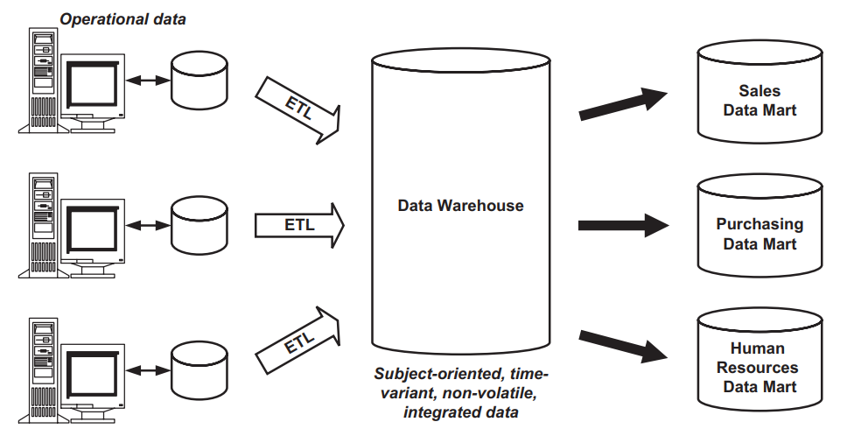
Data warehouse architecture

Slide 63
Business Intelligence – Data warehouse
The data warehouse contains the data that is
Subject oriented
Time-variant
Non-volatile
Integrated

Slide 64
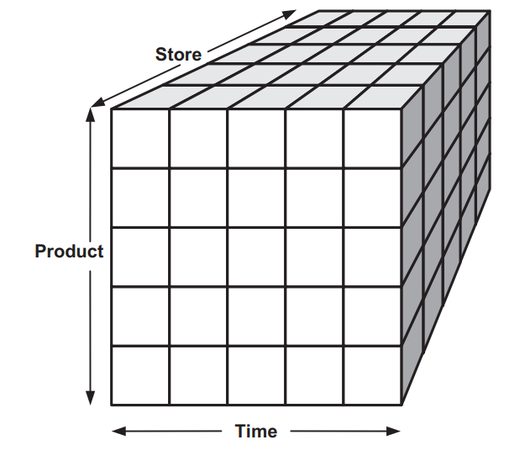
Business intelligence – The multidimensional model of data
The data warehouse is easily visualize the data as a cube by 3/4/5/more dimensions
Cubes with more than three dimensions are sometimes known as ‘hypercubes’.
Once structured in this way the
data can be:
Used with standard reporting tools
Queried using OLAP techniques
Subject to data mining.

Slide 65
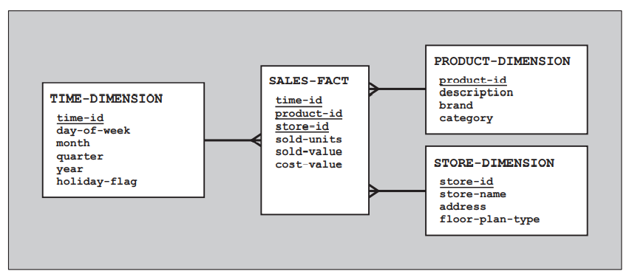
Business intelligence – A relational schema for a data warehouse
The multidimensional model of data, is possible to emulate the multidimensional view of data using a relational database management system.
Our three-dimensional cube (product, store and time) could be represented using the star schema

Slide 66
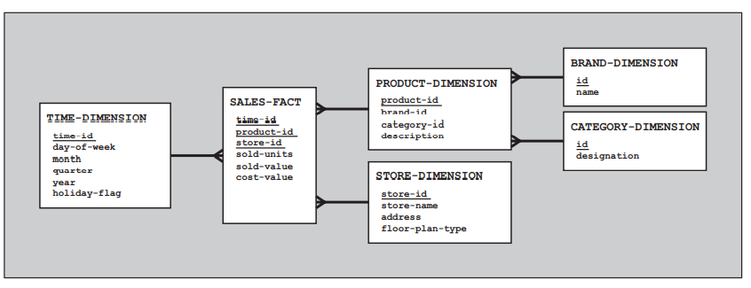
Business intelligence – A relational schema for a data warehouse
Variations on Star schema: Snowflake and Galaxy
Snowflake schema – introduces the degree of normalization in to dimensions

Slide 67
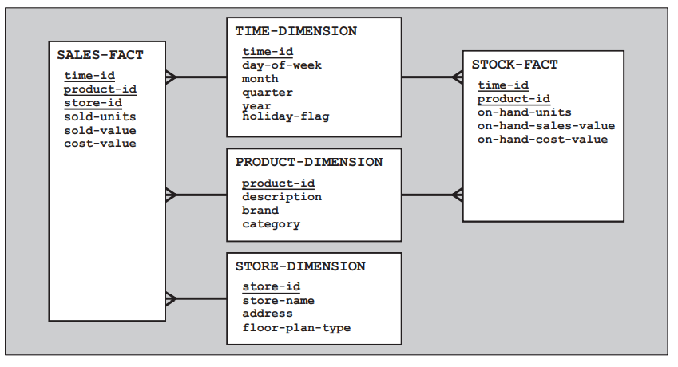
Business intelligence – A relational schema for a data warehouse
Galaxy schema – Schema where two or more fact tables share one or more of the dimensions.

Slide 68
CRM
Orchestrate your business and get your team on the same page with a central repository of customer data.
Business success – Depends on Customers
Harder economic fundamentals,
Increasing competition,
Stricter regulations,
Digital disrupters,
Demanding customers,
Mobility, and
Price sensitivity
Shifting the power from Companies to Customer

Slide 69
CRM
Where do they want to go with it?
How do they view the outcome?
What do they expect from the system?
What is the role they play in this journey?

Slide 70
CRM - Pillars
For implementation and they deliver value to the business:
Operational CRM: The operational CRM is all about marketing, sales, and services functionalities.
Analytical CRM: The analytical CRM will use the data collected from the operational CRM and provide users and business leaders with data about business performance as they require
Collaboration CRM: The collaboration CRM will provide the technology to integrate all kinds of communication channels and frontends with core CRM for both internal and external users

Slide 71
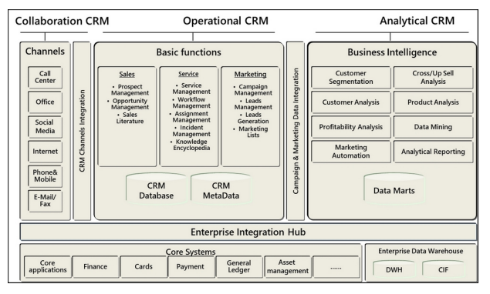
Pillars of CRM
Able to create a comprehensive view of your business and manage clients' communication over all your channels.

Slide 72
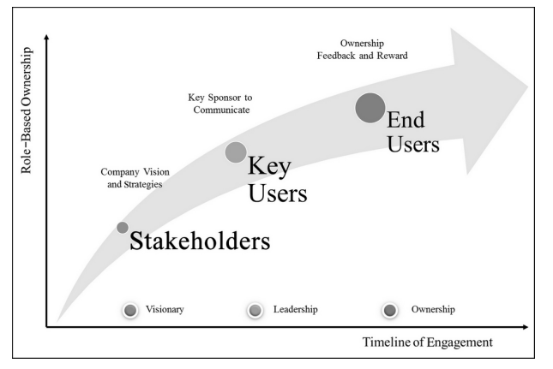
Pillars of CRM - Level of Engagement
Helps to identify the metrics for KPI & Total Cost of Ownership and Return on Investment (TCO/ROI) of your project.

Slide 73
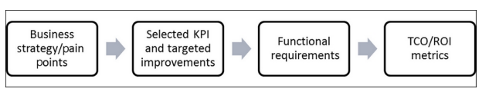
Pillars of CRM - Level of Engagement
Steps defining TCO/ROI metrics
CRM projects is building a comprehensive 360- degree client view that will be a supporting pillar for sales, marketing, and services processes automation.
It is also important to support and services processes automation. It is also important to support managing the business and resources more efficiently based on insightful decisions, at a reduced cost of operation.

Slide 74
KYC – Know Your Customer
A common definition of a single customer view is an aggregated and holistic presentation of client data that's being held by a company or by its business units.
This data could come from multiple sources,
Related terms for single customer view
360-degree client view
Client single view (CSV)
Single customer view (SCV)
Single customer repository

Slide 75
KYC – 360-degree client view
The 360-degree client view will not only be the tool that your company uses to record and assist the customer across all your channels with the best possible customer experience, but it will be the strategic approach for your business to streamline processes and reduce operational costs.
Type of client data needed in order for the business unit to be more efficient.
customers (role-based). A discussion about how much information is Additionally, it's important to define who should be entitled to see what type of data (entitlement) from customers (role-based).

Slide 76
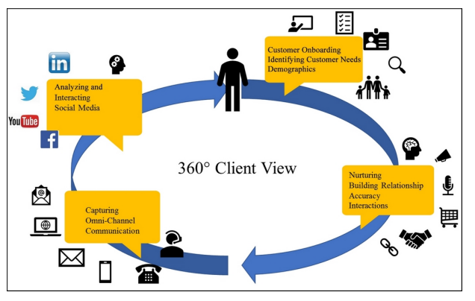
KYC – 360-degree client view

Slide 77
KYC – 360-degree client view
Building a 360-degree client view could have many more faces, such as the size of the organization, the role of the user, the processes involved, the business unit requirements, the nature of the industry, and the client segment, to name a few.
Multiple parameters for 360-degree client view
Volume, Segment, Size, and the nature of your business.
Build trust relationship –
Manage the wealth of customers
Advise the future planning
Customer Life Cycle Management
Customer Health Index – Empower your employees

Slide 78
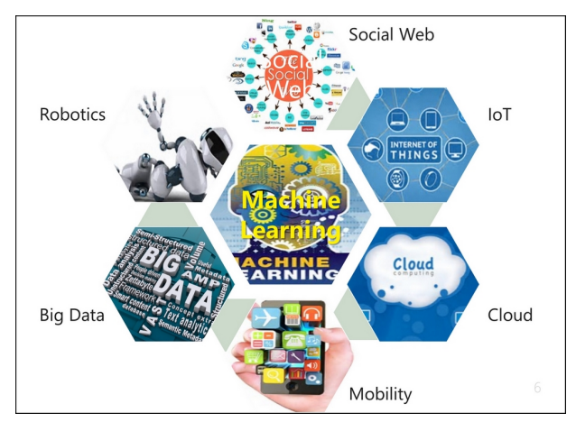
Utilizing AI and ML in CRM Strategy
AI and ML support CRM processes to enrich traditional business applications
Digital Business
2013 @ 5% , 2022 @ 85%
Nine out of 10 young customers
Technologies

Slide 79
Evolution of AI
In 1940, AI was key component in Science fiction films as a story telling
Algorithms and theories rooted from 1950’s
1980’s the first machine with AI Systems were developed
A subset of AI is ML. In the 1990s, ML was reorganized as a separate field from AI and from there it began to flourish.
It certainly benefited from the increasing availability of digitized information, and the adoption of the internet in order to exchange information and data

Slide 80
Evolution of AI
The development of ML shifted away from the traditional approaches it had inherited from AI and more toward methods and models borrowed from statistics and probability theory.
ML changed its desire of achieving comprehensive AI to tackling solvable problems of a practical nature using data.
The algorithms of ML can leverage mathematical models from sample data and, in turn, make predictions or decisions without being explicitly programmed to do so.

Slide 81
The Current state of AI
AI today is used in almost all fields and industries, including consumer, healthcare, finance, government, and automotive.
Search engines: Such as Microsoft Bing or Google search.
Autonomous vehicles: Such as airplanes and self-driving cars.
Medical diagnosis: Such as predicting the chances of you having cancer
Playing games: Such as chess or Go.
Online assistants: Such as Apple's Siri or Amazon's Alexa.
Creating art: Such as poetry.
Speech recognition: Such as speech-to-text software.
Image and pattern recognition: Such as spam filtering and targeting online advertisements.

Slide 82
The Current state of AI
One of the first mass AI-driven business applications ever was the AutoCorrect feature in Microsoft Office, which was first introduced by MS office in 1993
Big Data + Affordable HPC + Deep Neural Networks = Progress in AI
Text analysis and understanding
Image understanding
Speech recognition
Robotics
Deep learning (ML)
IoT

Slide 83
The Teaming up AI with People
AI will expand functional areas of our daily lives.
In terms of CRM, the opportunities AI presents are endless: from operational efficiencies to improved customer satisfaction and increased productivity and revenue.
High priorities in regards to leveraging AI in business:
Marketing
Social media
Chat bots
Operational efficiency
Logistics
Supply chain

Slide 84
The Teaming up AI with People
AI algorithms are good for repetitive tasks that are well defined, such as
Customer service,
Processing a large amount of data,
Finding patterns within that data, and
statistical reasoning for decision making, such as in
Business intelligence, reporting, and forecasting.
Teaming up AI with real people in order to allow them to collaborate and work together, using their abilities and their strengths to achieve the maximum return for businesses.

Slide 85
Applying AI to CRM Solution
How we could apply all these technologies into our CRM design.
How we could set the stage for collaboration between people and AI systems in order to achieve more.
How can we leverage these technologies for improving processes in sales, marketing, and customer service?
Actually, CRM vendors are already infusing AI into their cloud applications. For example, Microsoft Dynamics 365

Slide 86
Applying AI to CRM Solution
By mixing AI and CRM, you will gain
Key performance analytics,
Coupled with easy,
Natural language queries,
In order to respond quickly with the uncovered information and trends in data.
By proactively analyzing data using ML models, you can gain insights into your performance and KPIs.
These are elements can provide better visibility into your business forecast, actuals, pipeline, leads, and activities.

Slide 87
The ethical aspects of AI
One important aspect of AI development: the ethical questions around it.
A key principle here is that AI will partly be used to augment human intelligence, but this is not always the case, nor should this be done in an uncontrolled way.
Augmenting humans is not the sole problem for the field of AI, must also understand the impact of this space.
Make thoughtful and transparent decisions to mitigate the potential risks from leveraging AI.
Engage both employees and customers in the stages of the processes and create transparency in all these discussions.

Slide 88
The ethical aspects of AI
2018 Facebook/Cambridge Analytica scandal, where it was revealed that millions of records of user data had been misused in the run-up to the U.S. election and the UK's Brexit referendum with social marketing techniques that were based on AI.
The ethical design and human control factor have to be a part of every AI and big data project today.
There's no doubt across the industry today that AI, ML, and data modeling have to be transparent for all the people involved, whether that is the company or the customer.
Ethics committees that review the use of AI, when designing CRM solution

Slide 89
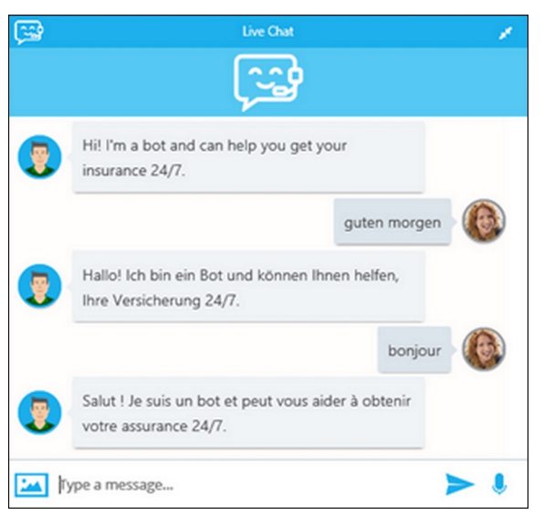
An example of AI in CRM Processes
More and more organizations starting to realize the power of AI when combined in a CRM platform.
Four design technologies
Bot Framework (or conversation agents)
Language Understanding Intelligent Service (LUIS)
Cognitive Services
Translation Services
Insurance case

Slide 90
The Deployment of a CRM platform
Deployment option – Microsoft Dynamics 365, Salesforce.com,…
A mixture of the on-premise and cloud deployment options, referred as Hybrid options
such as Infrastructure as a Service (IaaS) or Software as a Service (SaaS) deployment
Deployment factors
Business requirement & Fit gap
Cost-value matrix
User acceptance
Technical consideration
Explicit & Implicit costs
Regulatory Compliance

Slide 91
Factors Influencing Vendor Selection
Vendor selection factors
Capabilities of the Platform
Cost of the system
Complexity & Feasibility for Customization
Portability & deployment limitations
No. of International data centers
Training & Skills required

Slide 92
Factors Influencing Vendor Selection
Cost and Complexity
The initial costs: License, infrastructure, and so on.
The implementation time: It needs to be short.
The degree of customizations: Must be lower than 5%.
The control over the data and the solution: Including backups & updates
The on going maintenance costs.
Cloud deployment (Amazon Elastic Compute Cloud, MS Azure)
Solution capabilities
Collaboration with internal IT
Regulation
Speed, Security & Portability

Slide 93
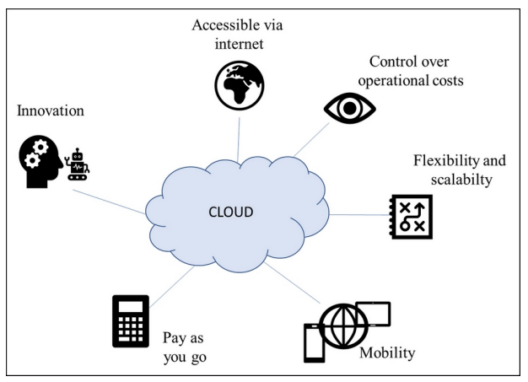

Slide 94
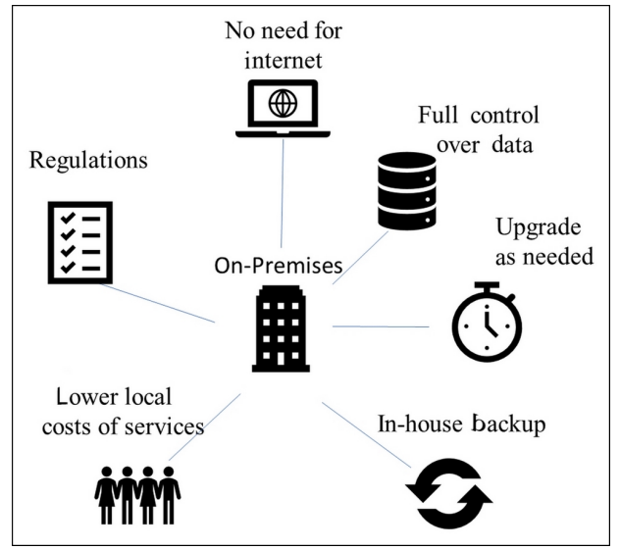
Factors Influencing Vendor Selection
On-premise deployment

Slide 95
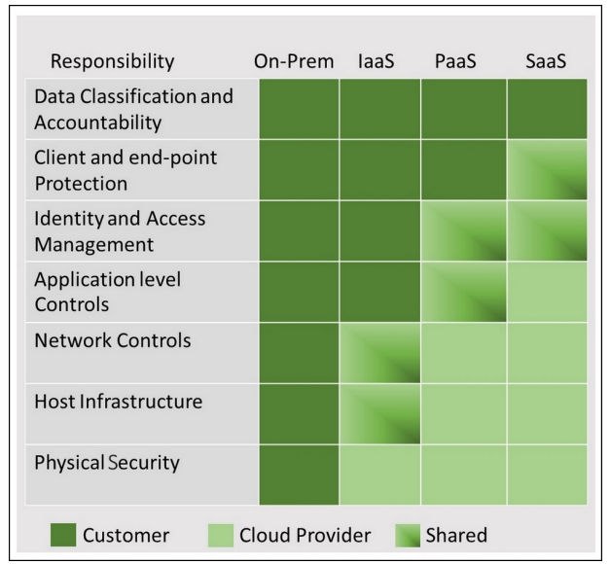
Mixed Deployment
IaaS, SaaS & PaaS

Slide 96
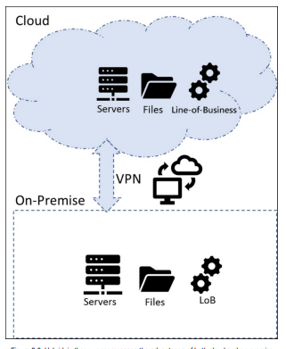
Hybrid Development

Slide 97
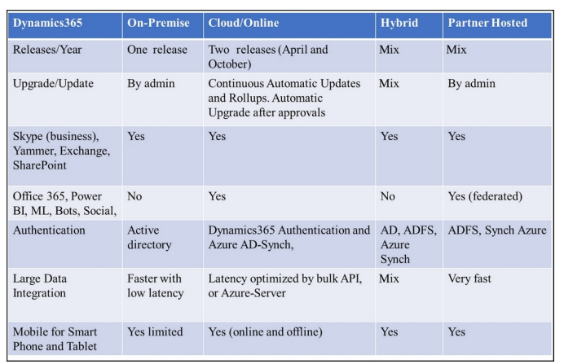

Slide 98
CRM Differentiators Feature list – Eco System
Instead of CRM elements – The ECO system support Business
Innovation in CRM technologies
Industry 4.0
AI and Cognitive Service – Has great impact in CRM platforms
Fourth Industrial Revelation – Two main driver for CRM
Digitization, Collaborate & Connect with each other
Massive Innovations Technology

Slide 99
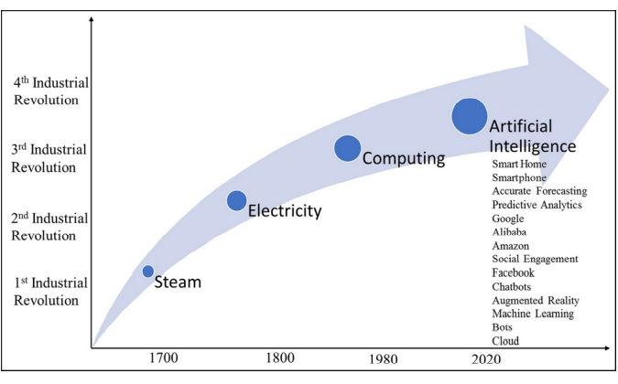
Industry 4.0

Slide 100
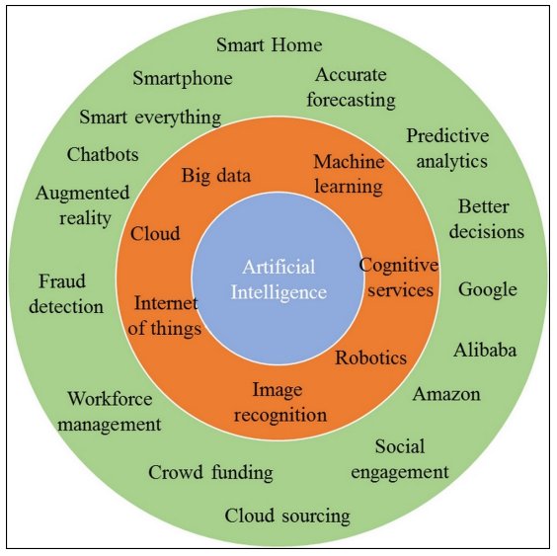
AI and Smart Cloud
Revolution driven by AI
Advances in Computer Power
Memory size

Slide 101
To Cloud or Not to Cloud
What options are there?
What are the best practices?
Should all applications move to the cloud or only some of them?
What are the pros and cons of private cloud versus public cloud
The company wanted to understand the integration and deployment options.
This element was mainly focused on how to set up a hybrid application infrastructure in order to benefit from cloud services and on-premise.
My general advice is that if you move to the cloud, then you don't want to move all your business applications to the cloud at once.

Slide 102
To Cloud or Not to Cloud
Total ownership/return on investment (TCO/ROI) analysis on all three
1. Stay where you are, on-premise, and improve what you have.
2. Move from on-premise and adapt to the cloud gradually.
3. Move to the cloud entirely with your core applications.
Leveraging smart cloud into CRM
Business scenarios for CRM applications
Routing cases by sentiment with cognitive services text analytics.
The intelligent agent assistant, namely bots in the agent desktop
Leveraging ML and AI to automatically extract metadata from audio and video files

Slide 103
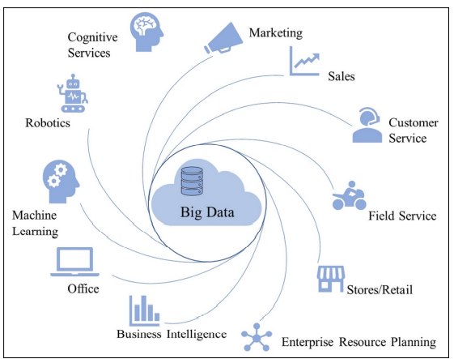
Big data
Big data, as a topic, is the new science for dealing with datasets that are too large or complex to be dealt with using traditional data processing applications.
It's the science of leveraging AI and ML to analyze systematically extracted information from a variety of sources

Slide 104
Social selling and advertising
Social selling is the process of developing sales over social network platforms and it is an integrated part of the modern sales process.
Social selling techniques include branding and interacting directly with potential buyers and customers, which will help you to develop leads and opportunities with integrated social listening in your CRM strategies.
The concept is gaining huge popularity in a variety of industries, such as financial advisory services, the automotive industry, and consumer products.
Social selling is the main source of income for a selection of social media platforms.

Slide 105
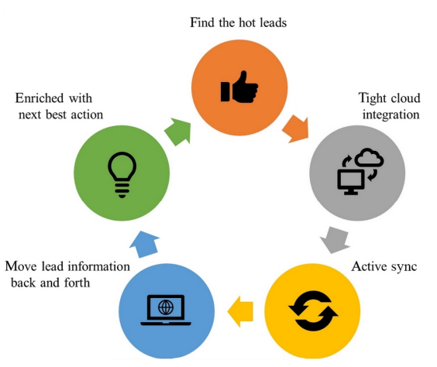
Social Selling Process

Slide 106
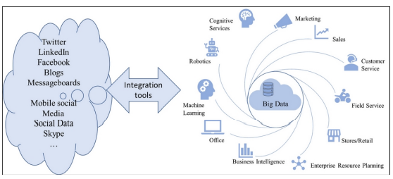
Social Selling Process

Slide 107
Implementation tools
Challenge is create platform that support entire business applications processes
Microsoft Power Platform
Components
Power BI
Power Apps
Flow
Common Data model
Power BI is a business analytics service from Microsoft. It provides simple-to-use business intelligence and interactive visualization tools that allow users to create their own dashboards and reports on the fly
PowerApps is an application development environment that provides

Slide 108
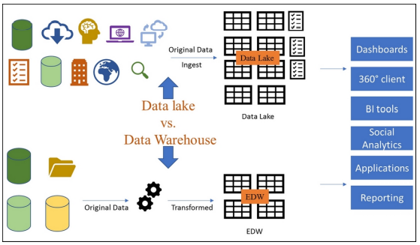
Implementation tools
PowerApps is an application development environment that provides services, connectors, and a data platform.
Share point, Excel, MS 365 etc…

Slide 109
Sustainable Platform
In designing a sustainable CRM strategy, it is legitimate to ask how CRM platforms today will differ tomorrow.
The challenge is twofold;
Need to integrate and leverage big data across the organization
Need to expand your applications into the cloud seamlessly.
CRM platform must leverage cloud intelligent services (smart cloud) to expand and drive business outcomes.
Platform that enables you to greatly increase your reach and to serve more customers, while reducing operational costs.
Your CRM will have to leverage the cloud and XaaS (virtually everything as a service) in the smart cloud to scale and support customer interaction channels.
Microsoft Power Platform
Components
Power BI
Power Apps
Flow
Common Data model
Power BI is a business analytics service from Microsoft. It provides simple-to-use business intelligence and interactive visualization tools that allow users to create their own dashboards and reports on the fly
PowerApps is an application development environment that provides

